Slide 1
ESG Risk Score
Analysis
Portfolio
VS Benchmark
Analysed by: Aman Mourya
Email id: amanmourya152@gmail.com
Source data: Interview Project
Source Code:

Slide 2
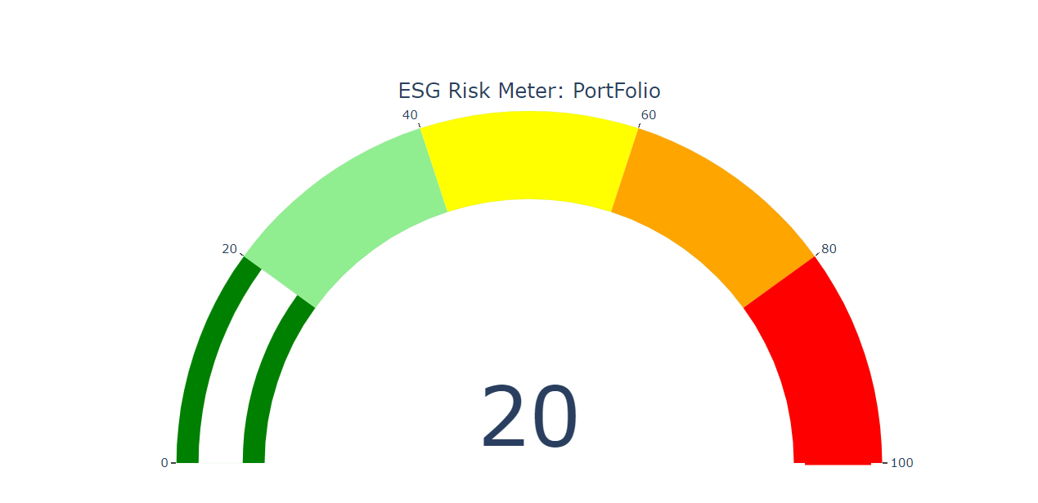
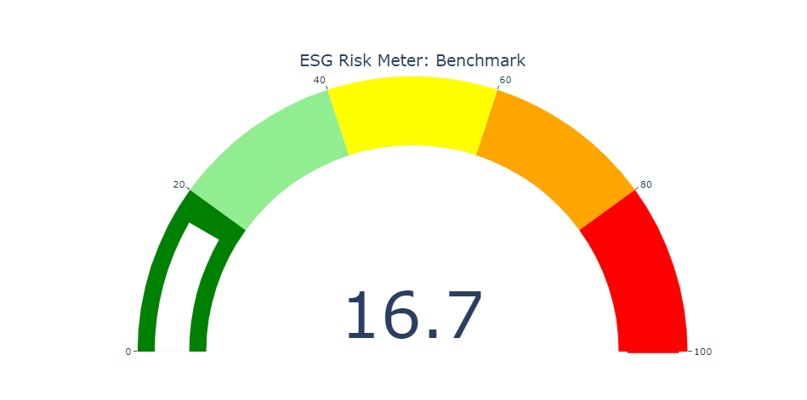
Risk Meter

Slide 3
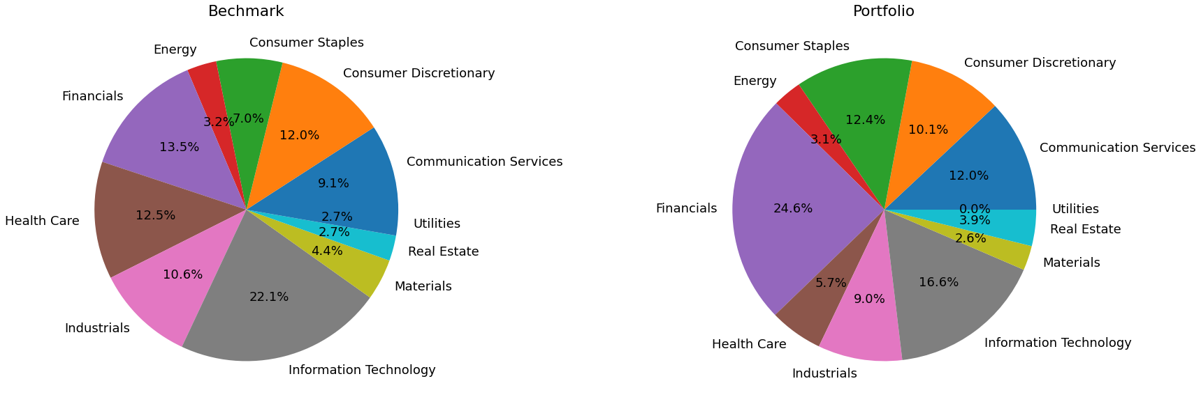
Weightage Comparison
Sector | Bench. Weight | Port. Weight
Communication Services | 9.14 | 12
Consumer Discretionary | 12.02 | 10.06
Consumer Staples | 7.03 | 12.43
Energy | 3.15 | 3.09
Financials | 13.53 | 24.6
Health Care | 12.54 | 5.68
Industrials | 10.59 | 8.97
Information Technology | 22.12 | 16.6
Materials | 4.4 | 2.62
Real Estate | 2.71 | 3.87
Utilities | 2.74 | 0

Slide 4
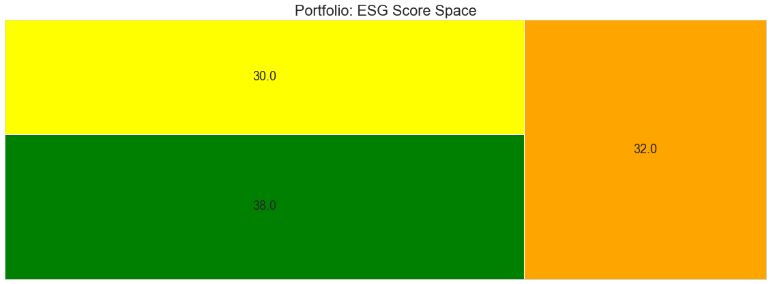
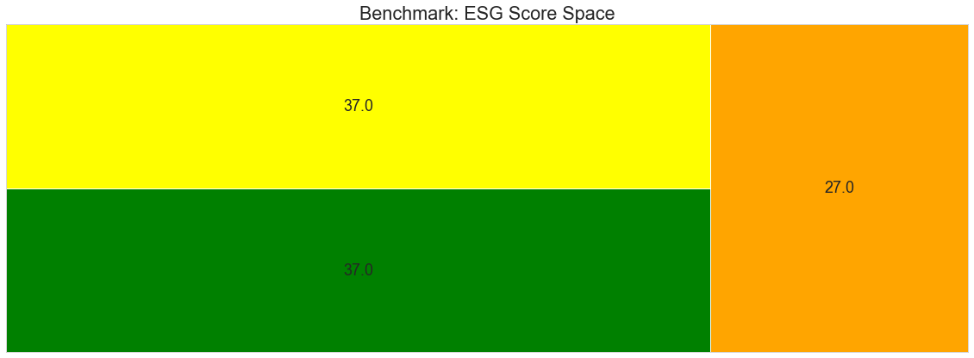
ESG Pillar Comparison

Slide 5
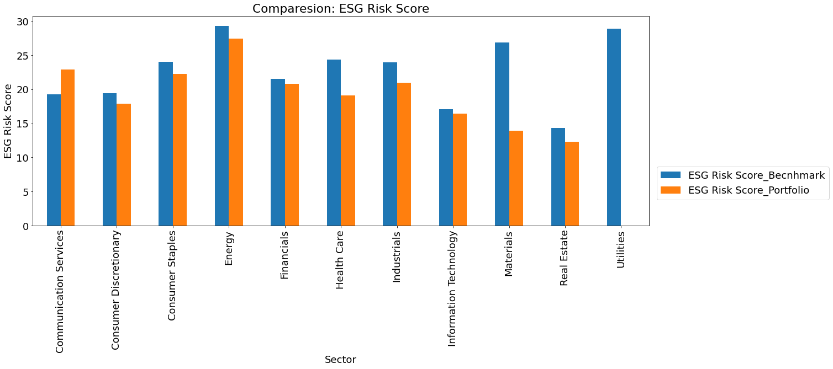
ESG Risk Score Comparison
Sector | Bench. Weight | Port. Weight
Communication Services | 9.14 | 12
Consumer Discretionary | 12.02 | 10.06
Consumer Staples | 7.03 | 12.43
Energy | 3.15 | 3.09
Financials | 13.53 | 24.6
Health Care | 12.54 | 5.68
Industrials | 10.59 | 8.97
Information Technology | 22.12 | 16.6
Materials | 4.4 | 2.62
Real Estate | 2.71 | 3.87
Utilities | 2.74 | 0

Slide 6
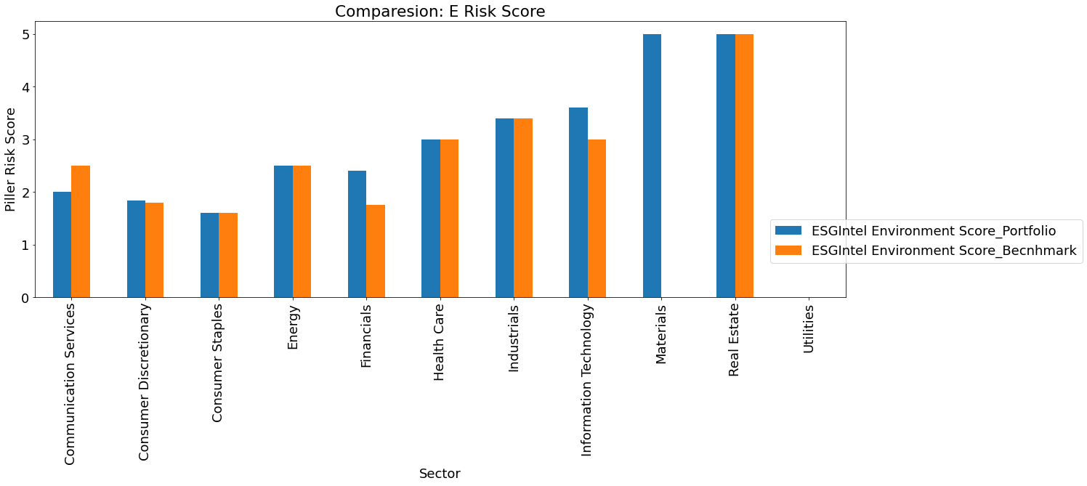
Environmental Risk Score Comparison

Slide 7
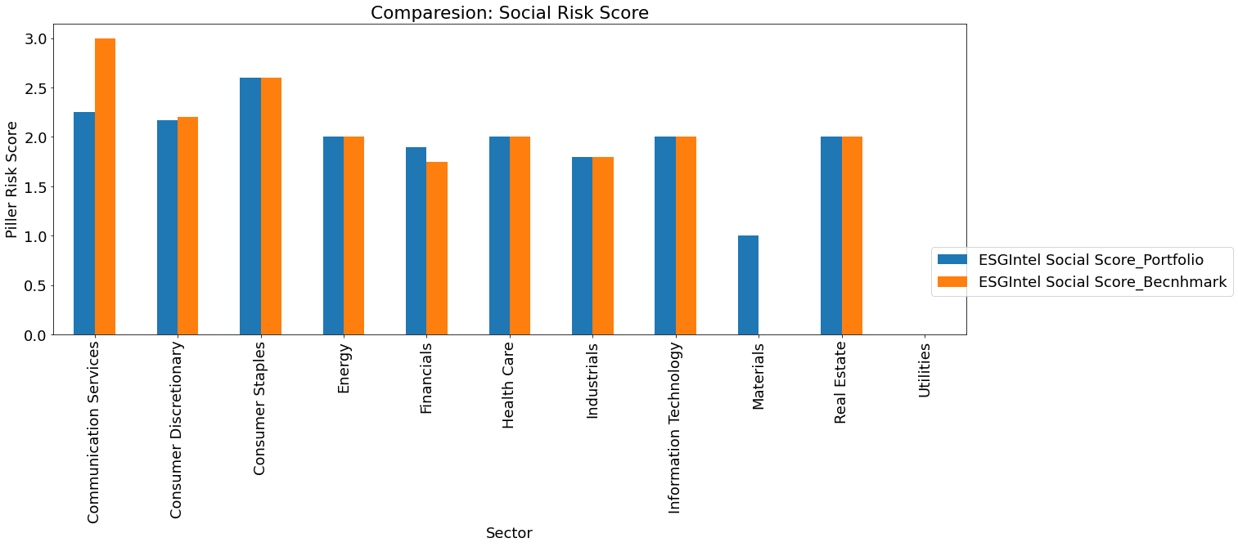
Social Risk Score Comparison

Slide 8

Governance Risk Score Comparison

Slide 9
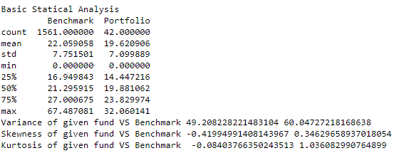
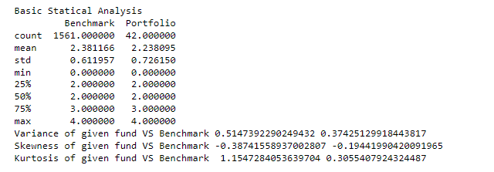
Basic Statical Analysis
of Portfolio and Benchmark
ESG Score
ESG Intel Overall ESG Score

Slide 10
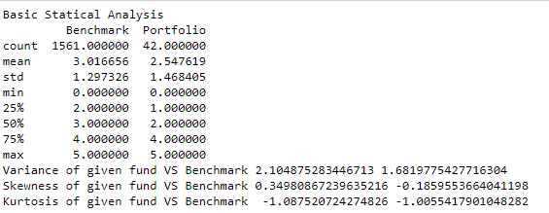
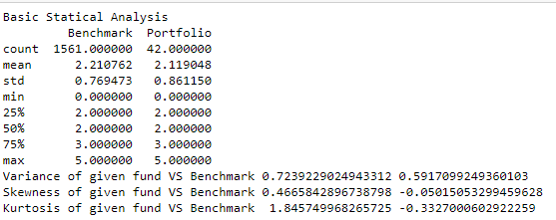
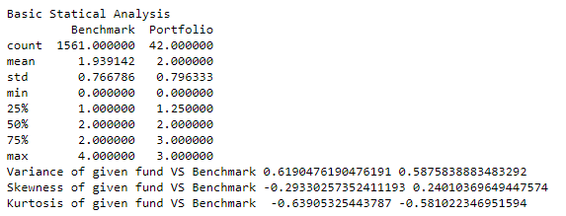
ESG Environmental Score
ESG Governance Score
ESG Social Score

